Slide 1
Planning Board Meeting
5:30 PM | September 22, 2022 | King Street Meeting Room

Slide 2
Agenda
1. Meeting Called to Order
2. Roll Call
3. Informal Public Comment
4. Adjustment of Agenda
5. August 8, 2022 Special Called Meeting Summary
6. 2045 Comprehensive Plan Steering Committee Discussion
7. Staff Updates
8. Adjournment

Slide 3
Public Comment
3
2

Slide 4
Public Comment
2
1

Slide 5
Public Comment
1
0

Slide 6
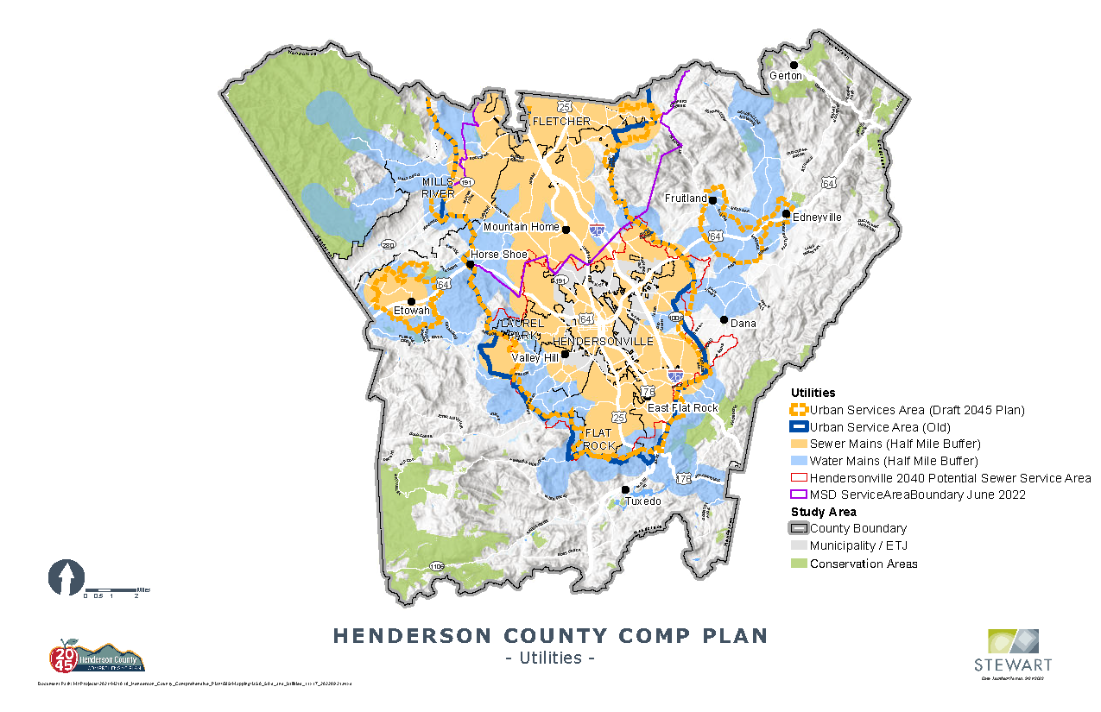

Slide 7
Dwelling Unit Density
Character Area | Density Recommendation | Similar Current Zoning
Medium Density Residential (MDR) | Density varies based on location & context | R1 – 4 to 12 units per acre
Low Density Residential (LDR) | 1 – 2 units per acre | R2 & R2R - 1 unit per 1 acre
Very Low Density Residential (VLD) | Typically 2+ acres per unit | R3 – 1 unit per 1.5 acres

Slide 8
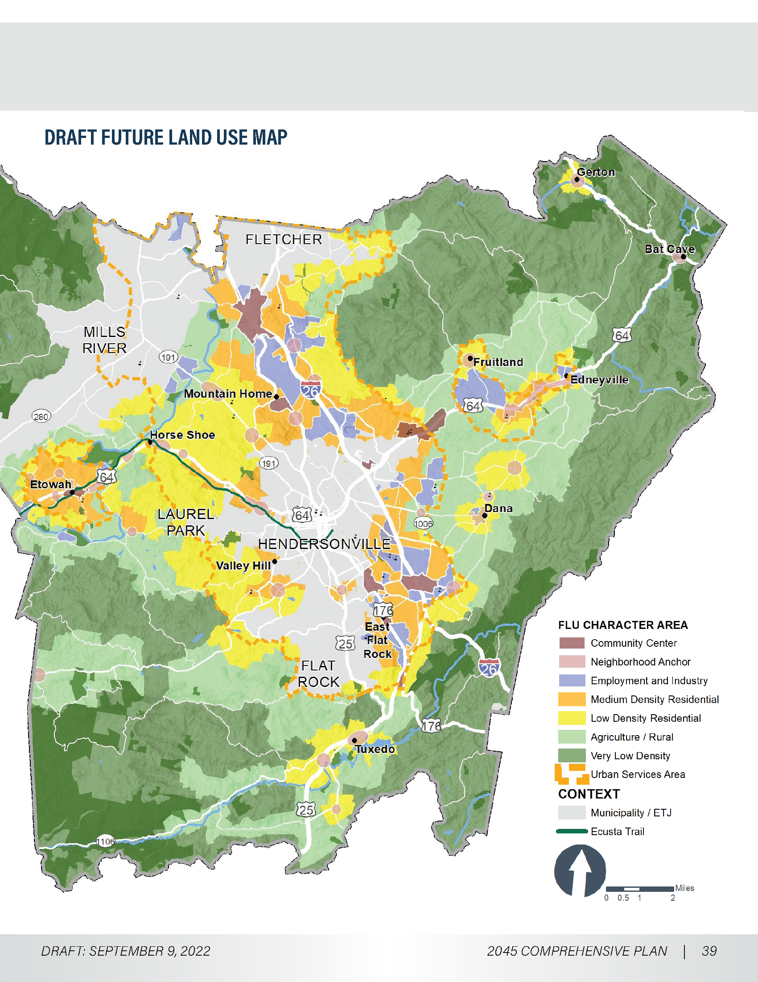

Slide 9
FAQs
The County adopted zoning in 2007
Also in ’07, a floodplain, soil & erosion control, water supply/watershed, and steep slope ordinances were adopted
This comprehensive plan will be reviewed every 5 years and updated at the 10 year mark.

Slide 10
FAQs
The key elements of the plan are not the maps, but rather the recommendations and action steps, which drives implementation.
The FLUM is a macro level vision for relative location for land uses that are inevitable with growth in any community
Amendments to the LDC will be required for zoning to reflect the FLUM vision. This will occur at the micro level.
Notes:
Census data helps to create context

Slide 11
FAQs
There are colors on all parts of the county except for the municipalities and the ETJs.
Municipalities have their own plans and zoning
In the United States, property owners have a given right to use, develop, or sell their property.
If the County slated any portion of private property as “not to be developed”, the County would be sued for what is called a regulatory taking.
Overregulating the use of land is upheld by the Supreme Court as the same as a taking
Notes:
1922 in Pennsylvania Coal v. Mahon. Justice Holmes - “while property may be regulated to a certain extent, if regulation goes too far it will be recognized as a taking.” just compensation required

