Slide 1
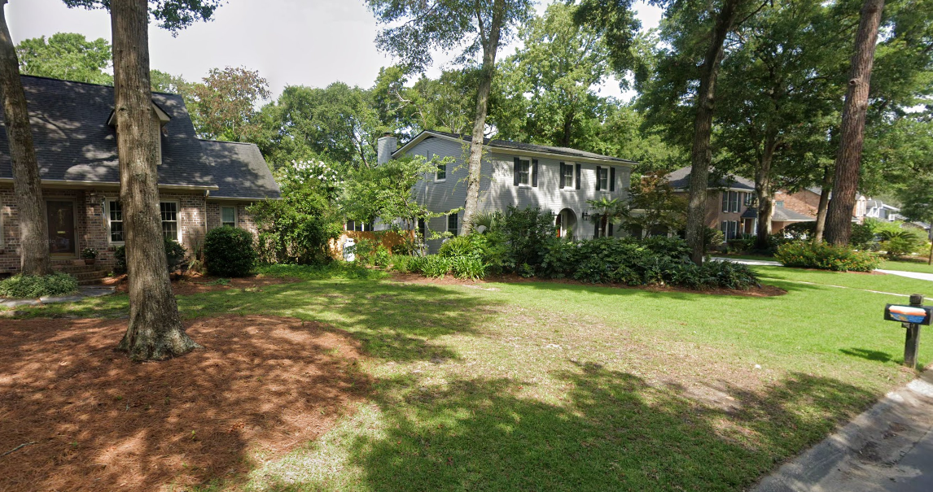
Let’s Talk About Density
Notes:
Many people—including some trained planners and designers—have difficulty estimating density from visual cues or distinguishing quantitative (measured) and qualitative (perceived) density.
Staff conducted an analysis of our current LDC, other rural counties, surrounding jurisdictions, and best practice to have a good basis for these recommendations.
Staff also reviewed current density across the County

Slide 2
Existing Density
Notes:
Liz will discuss the calculations and definitions of these statistics

Slide 3
Notes:
Liz will discuss calculations and how it relates spatially.

Slide 4
Density Discussion
Providing a broad range of housing densities is key to ensuring housing opportunities for all residents
The Comprehensive Plan is a high-level document and the wording in it should be treated as such
Character areas are NOT zoning districts
One character area may represent more than one zoning district
Thorough discussion will be required when reviewing amendments to the Land Development Code

Slide 5
Density Discussion
Increased density reduces land consumption i.e., farms and natural resources
Higher density should occur in areas with services
Lower densities should be in areas without services and adequate road networks
Major residential development within the VLD Character Area should be discouraged
Residential development within the OSC should be highly discouraged
OSC areas have sensitive ecosystems, natural resources, steep slopes, and other environmental conditions that are not conducive to development
Notes:
The typical suburban low density of 3 units per acre requires 4x as much land as a medium density of 12 units per acre.
At larger scales (as we grow), this difference can mean the difference in losing entire farms to accommodate the lower density.
Example: 1,000 homes consume 250 more acres when built at low density levels
At a small development scale, this may seem like a negligible difference. To build 10 houses at the lower density, only 29 more acres of land would be needed. But when the growth rate is high and the number of households rises, the need for land also rises dramatically. One thousand new homes at a suburban low density would consume 250 more acres of land than they would at a medium density. That development would most likely be on soils suitable for agriculture or on land that provides an important ecological function.

Slide 6
Distributed Density
Notes:
Density Done Right
How distributed urban density can support healthy, livable, neighborhoods, housing affordability, and the environment (Ryerson University in Canada)

Slide 7
Too Much… Too Little… Just Right!
Notes:
With all of this information, it is still necessary for y’all to contemplate densities that are right for HENDERSON COUNTY

Slide 8
Density Discussion
Character Area
Higher density range
Lower density range
Very Low Density (VLD)
1 unit per 3 acres
1 unit per 5 acres
Agriculture/Rural (AR)
1 unit per 1 acre
1 unit per 3 acres
Low Density (LD)
4 units per 1 acre
2 units per 1 acre
Medium Density (MD)
8 units per 1 acre
14 units per 1 acre
Notes:
High level – ranges are needed for flexibility
We studied cities across NC to really define “high” density.
Hendersonville’s high density definition validates the suggested density ranges for medium density

Slide 9
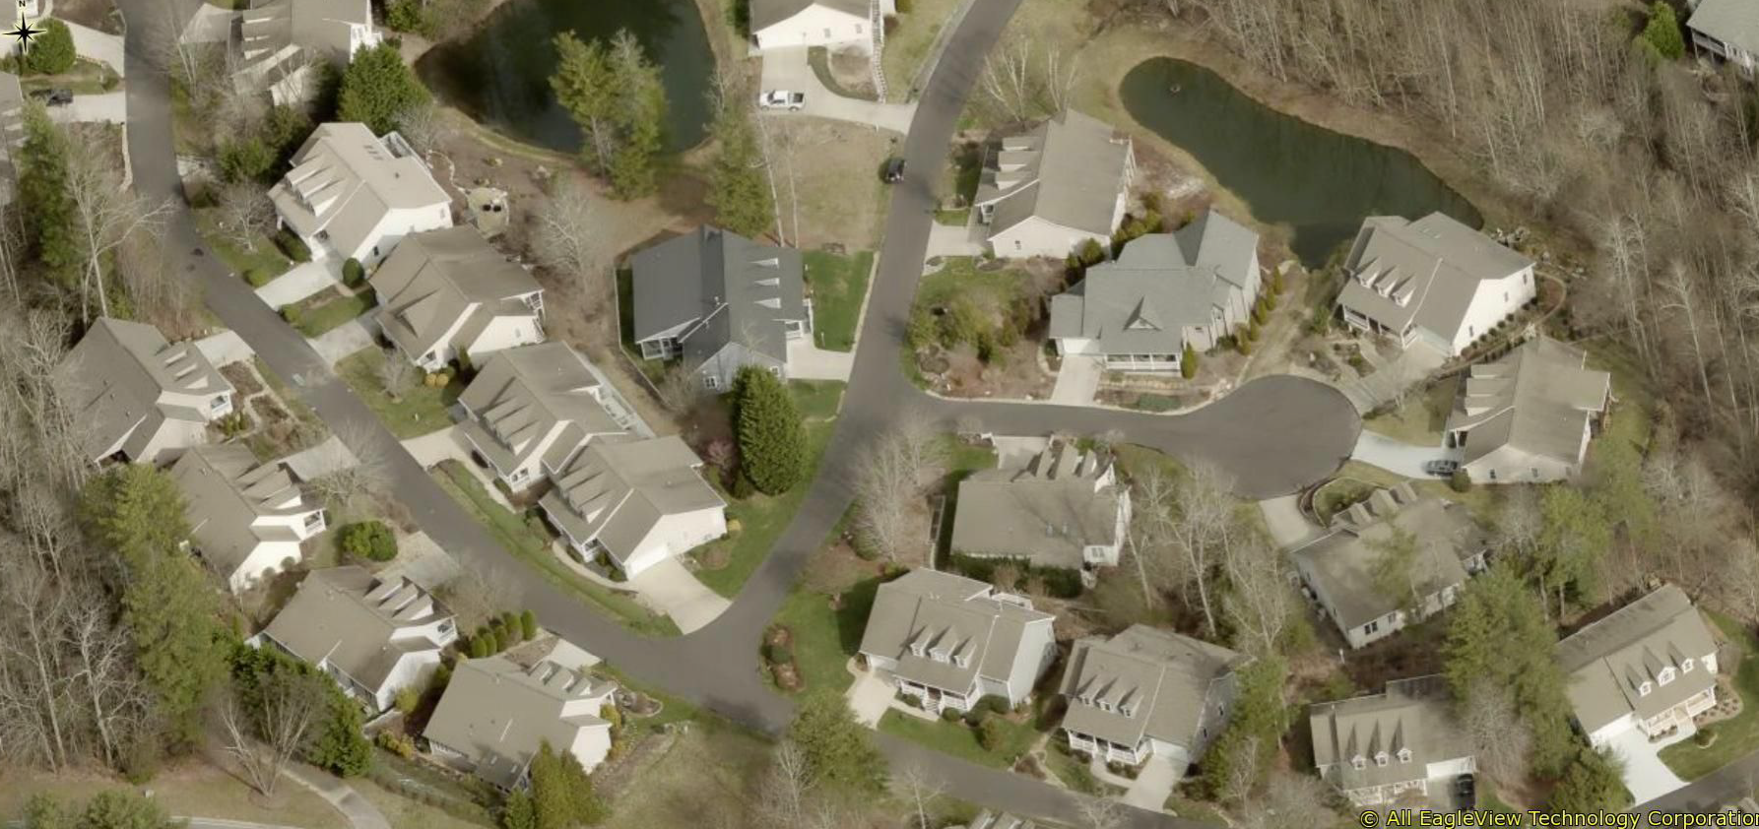
Examples
Carriage Park
3.64 units per acre
Notes:
3.64 units per acre

Slide 10
Examples
Grimesdale
1.67 units per acre
Notes:
1.67 units per acre

Slide 11
Examples
Kenmure
0.52 units per acre
Notes:
Seems low density at 1 unit per 2 acres – multi million dollar homes

Slide 12
Examples
Red Bird Lane
0.91 units per acre
Notes:
Older neighborhood off of Hwy 191/N Rugby Rd

Slide 13
Examples
Blacksmith Run
2.26 units per acre
Notes:
Revised (2021) overall neighborhood density (all phases)

