Slide 1
Change of Terminology
The term, Urban Service Area (USA), was disliked by many of the participants at the public input meetings as it was misleading. To clarify this is where the existing service area is.
Staff suggest two alternatives:
  Utility Service Area
  Utility Service District
Notes:
PAUSE – discuss the two names AND choose one before moving on.

Slide 2
Edits to Urban Service Area in Etowah
Participants at the public input meetings were uncomfortable with the size of the draft USA considering that extension of services is not eminent.
Staff altered the map to accurately reflect the current service area, but still shows potential for services extending east on US64.
  The existing draft USA along the 64 corridor was acceptable to public input meeting participants.
Notes:
NC granted a permit to Etowah sewer, but a developer or another sewer provider has to buy the plant to take advantage of the permit for expansion.

Slide 3
AUSTIN’S MAP GOES HERE

Slide 4
Density Discussion
Many people—including some trained planners and designers—have difficulty estimating density from visual cues or distinguishing quantitative (measured) and qualitative (perceived) density.
Staff conducted an analysis of our current LDC, other rural counties, surrounding jurisdictions, and best practice to have a good basis for these recommendations.
Staff also reviewed current density across the County

Slide 5
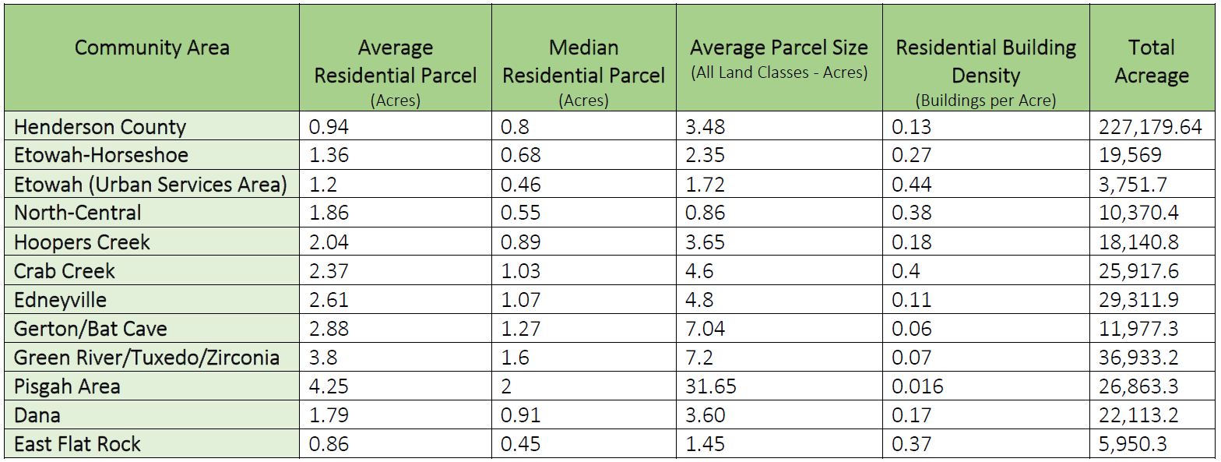
Existing Density
Notes:
Liz will discuss the calculations and definitions of these statistics

Slide 6
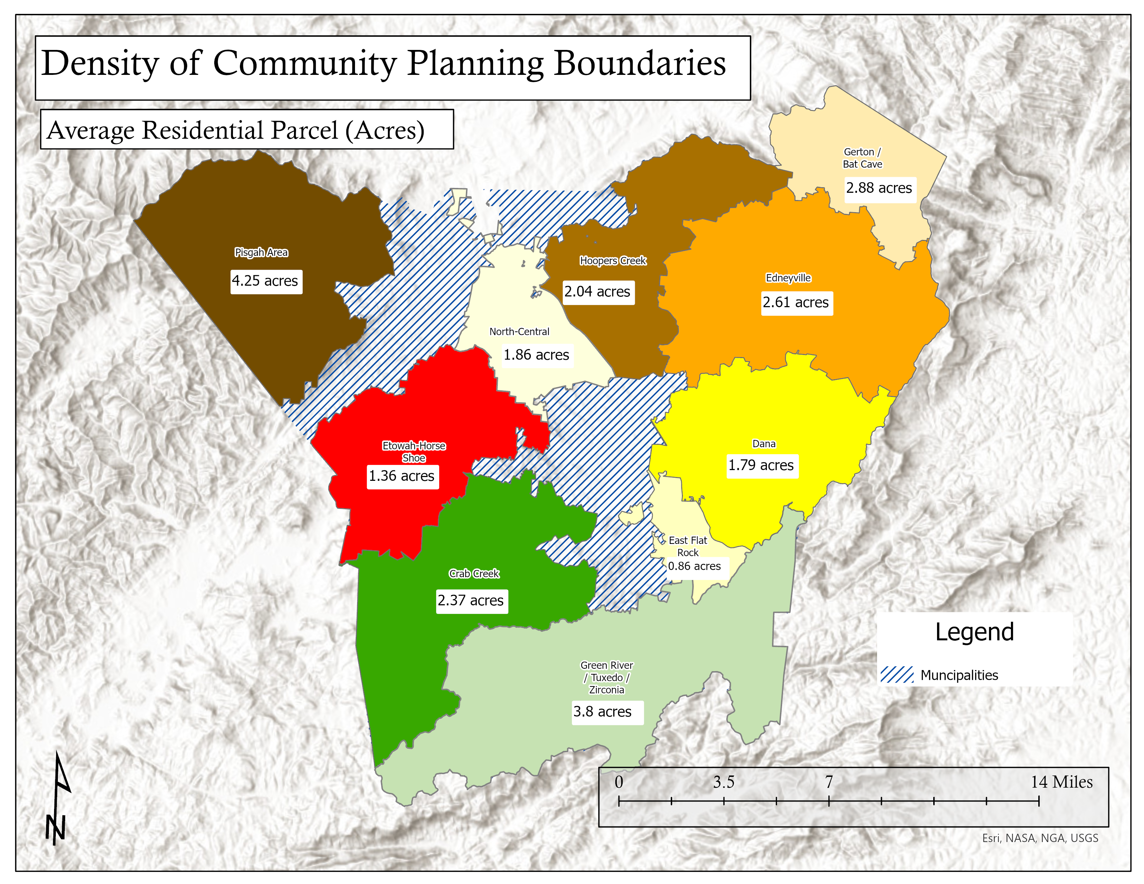
Notes:
Liz will discuss calculations and how it relates spatially.

Slide 7
Density Discussion
Discussion came up at BOC meeting
Providing a broad range of housing densities is key to ensuring housing opportunities for all residents
Suggested densities correlated with character areas are NOT the same as zoning districts
One character area may represent more than one zoning district
Thorough discussion will be required when reviewing amendments to the Land Development Code
The Comprehensive Plan is a high-level document and the wording in it should be treated as such

Slide 8
Density Discussion
Concentrating homes, jobs, schools, and shops into a smaller area helps us prosper, protect our environment, and save money for governments, developers, and consumers.
  A resident living at a density of 12 units per acre generates about one-third less of greenhouse gas emissions than someone driving the miles necessary to live at a density of 3 units per acre (Allen and McKeever 1996).
  Compact, mixed-use development requires fewer miles of roads and pipes, fewer police officers and fire fighters, and fewer square feet of public facilities per person to provide a specific level of service when compared to low-density, single use development.
Notes:
We tend to overestimate the density of monotonous, amenity-poor developments and underestimate the density of well-designed, attractive projects.
For the past century, we’ve been growing out—extending beyond the limits of existing settlements and converting farmland, deserts, and forests into building sites. Expansion outward is nothing new. The edges of our cities and towns have traditionally shifted to accommodate the need for built space. It’s the density of that new growth that has changed. T
The rapid pace of conversion from resource land to suburb is due not to the amount of development, but to its low density. We are spreading fewer people across each square mile and using up more land in the process.
The alternative to spreading out is to concentrate—to grow in and up. This is the way we grew before the automobile age, which transformed our sense of scale and distance.

Slide 9
Density Discussion
Living closer together helps save agricultural and resource land.
The typical suburban low density of 3 units per acre requires 4x as much land as a medium density of 12 units per acre.
At larger scales (as we grow), this difference can mean the difference in losing entire farms to accommodate the lower density.
  Example: 1,000 homes consume 250 more acres when built at low density levels
**To preserve farmland, open space, and the peripheries of public land, higher density is needed within the areas that have services.
  Major residential development within the VLD and AR Character Areas should be discouraged.
  Residential development within the OSC should be highly discouraged.
Notes:
At a small development scale, this may seem like a negligible difference. To build 10 houses at the lower density, only 29 more acres of land would be needed. But when the growth rate is high and the number of households rises, the need for land also rises dramatically. One thousand new homes at a suburban low density would consume 250 more acres of land than they would at a medium density. That development would most likely be on soils suitable for agriculture or on land that provides an important ecological function.

Slide 10
Density Discussion
Very Low Density (VLD)
  1 unit per 3 acres to 1 unit per 5 acres
Agriculture/Rural (AR)
  1 unit per 1 acre to 1 unit per 3 acres
  Large scale residential development is discouraged within this Character Area
  Density bonuses could occur on properties that have agricultural easement, PDR, TDR, or other preservation
Low Density (LD)
  1 unit per 0.25 acres to 1 unit per 2 acres (dependent upon w/s availability)
Medium Density (MD)
  8 units per 1 acre to 14 units per 1 acre
  Limit multifamily buildings to 3 stories tall
  Density bonuses could occur with particular stipulations
  For comparison, high density development in the City of Hendersonville is a maximum of 18 units per acre
Notes:
High level – ranges are needed for flexibility
We studied cities across NC to really define “high” density.
Hendersonville’s high density definition validates the suggested density ranges for medium density

