Slide 1
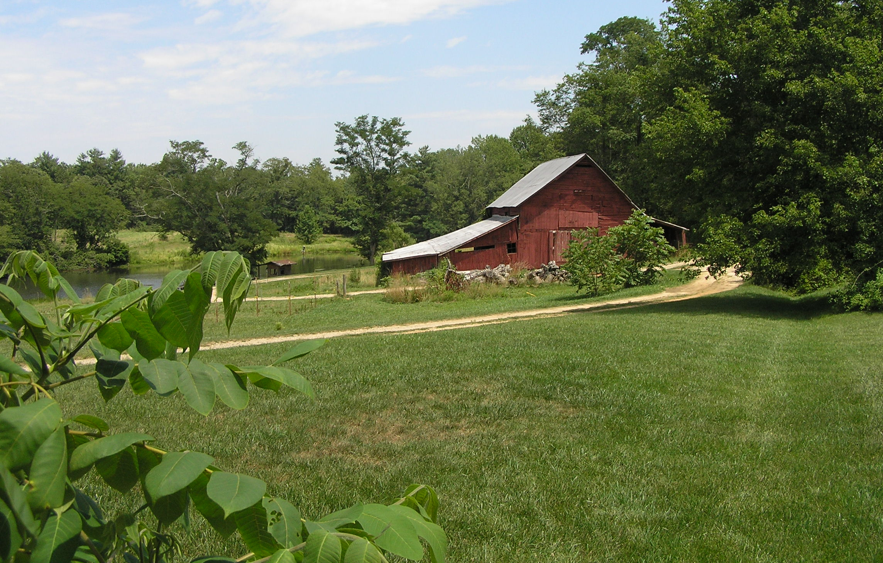
Henderson County 2045
Board of Commissioners
November 16, 2022

Slide 2
A COMPREHENSIVE PLAN IS...
Long-range
15 - 25-year time frame
Guidance
Land uses, intensity, design
Infrastructure investment
Collaborative
Documents a community conversation
Policy, not regulatory
Lays the groundwork for current and future regulations

Slide 3
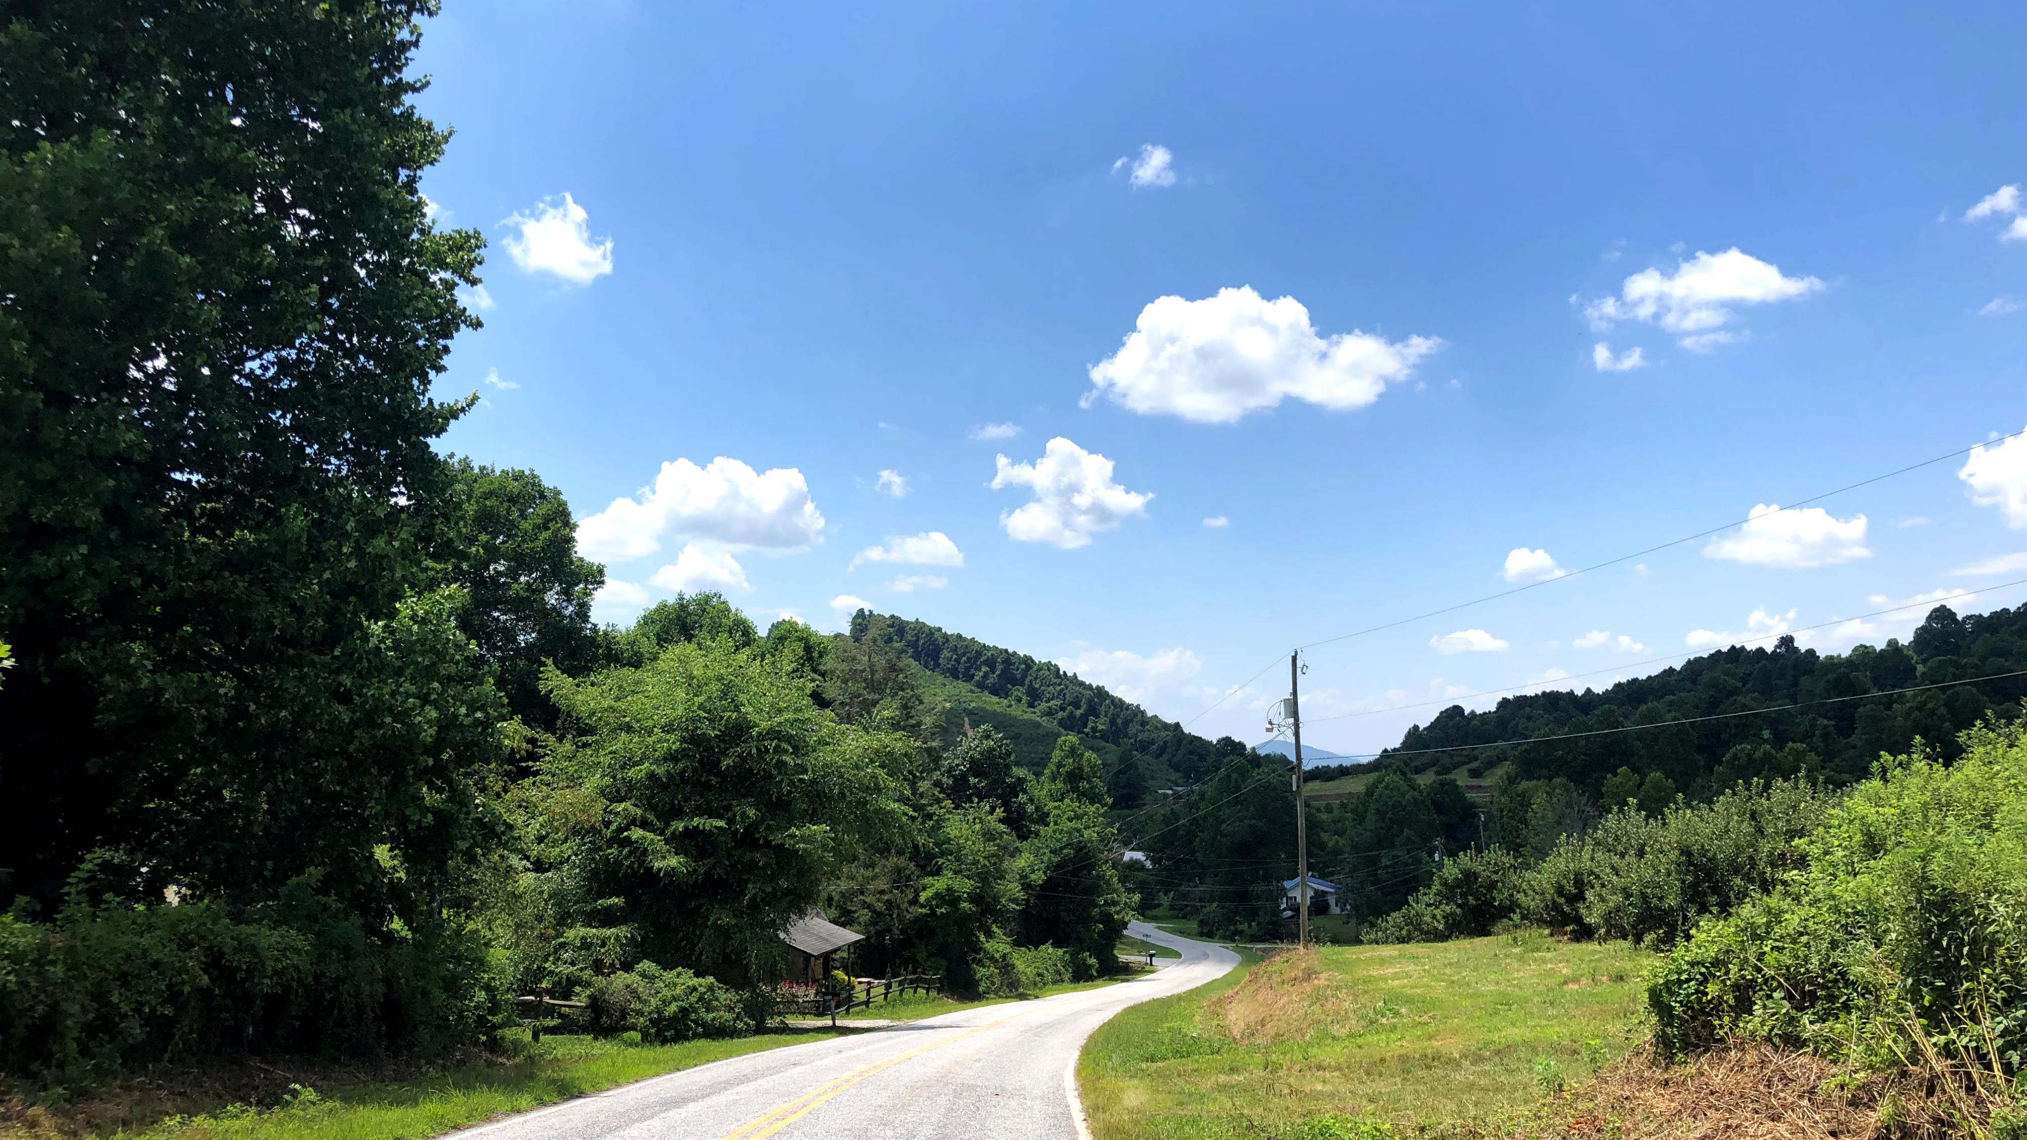
REVISING THE COMPREHENSIVE PLAN

Slide 4
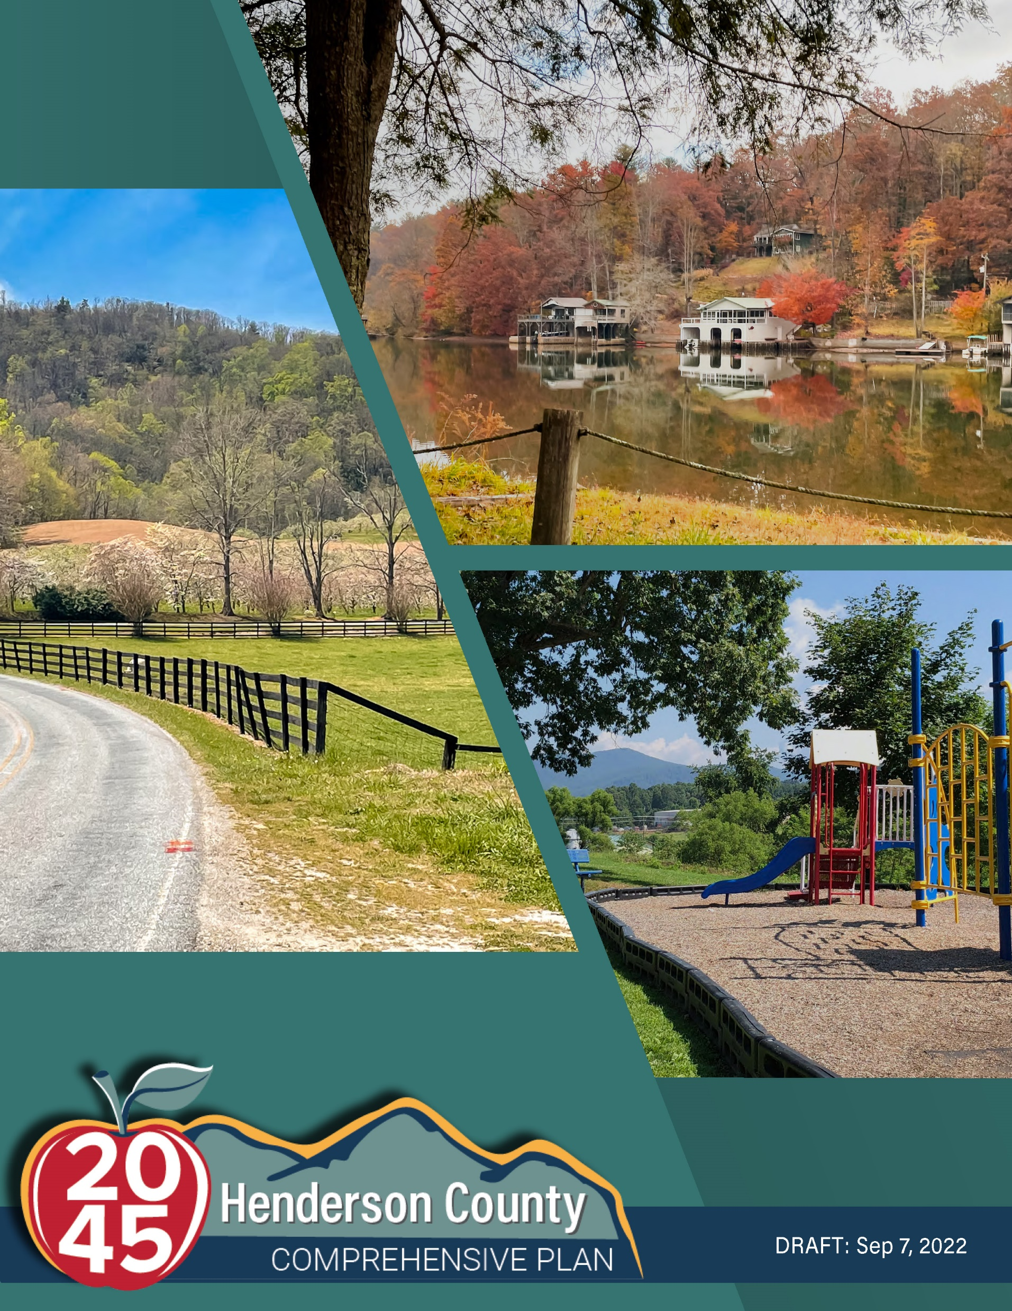
PROCESS TIMELINE
September 8th: Draft plan presented to Steering Committee at Special Called Meeting and copies were provided to the BOC
September 13th: Public Input Meeting at Hendersonville Library
September 20th: Public Input Meeting at Fletcher Library
September 26th: Public Input Meeting at Edneyville Community Center
September 27th: Public Input Meeting at Blue Ridge Community College
October 3rd: Public Input Meeting at Etowah Lions Club
Ongoing: Recorded presentation posted online as well as other virtual public input opportunities
Available to view online at www.HendersonCounty2045.com

Slide 5
PROCESS TIMELINE
September 22nd: Steering Committee received public comment and considered changes to the proposed USA boundary
October 20th: Steering Committee voted to rename the USA to Utility Service Area. They also voted to shrink the size of the Etowah USA boundary based upon public feedback. The Etowah community members that participated concurred with retaining an overall USA boundary
October 27th: The Steering Committee discussed and changed the Character Areas as well as the Future Land Use Map
November 4th: The revised draft with the Planning Board’s approved edits was posted online and given to the Commissioners and the Planning Board
Available to view online at www.HendersonCounty2045.com

Slide 6
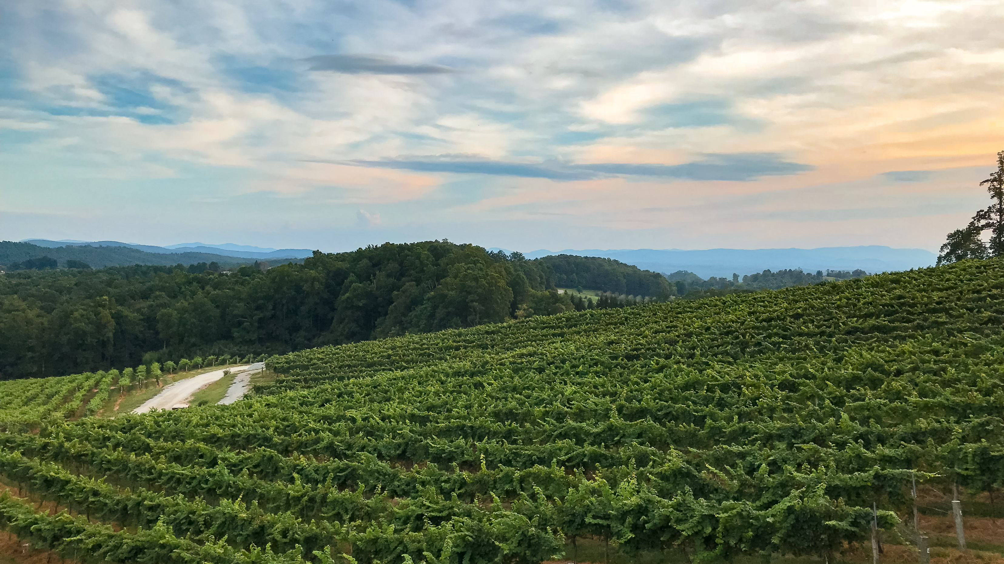
PLAN CHANGES

Slide 7
UTILITY SERVICE AREA
Represents an area already, and intended to be, served by utilities and other services by 2045.
Accounts for the existing services as well as the relative feasibility of sewer extension from sewer providers (City of Hendersonville, MSD, Etowah, and proposed Edneyville).
Although the County participates in an advisory capacity to MSD and communicates with other service providers, the County does not have any control regarding the extension of water or sewer from other entities.
When the sewer line is built at the Justice Academy and Edneyville Elementary, the County will be in control of extension and maintenance of those lines.
Utility extensions and service enhancements should generally be encouraged within the Utility Service Area.
The Etowah and Edneyville areas will be reexamined as the sewer situations change.
Notes:
Add where we are now.

Slide 8
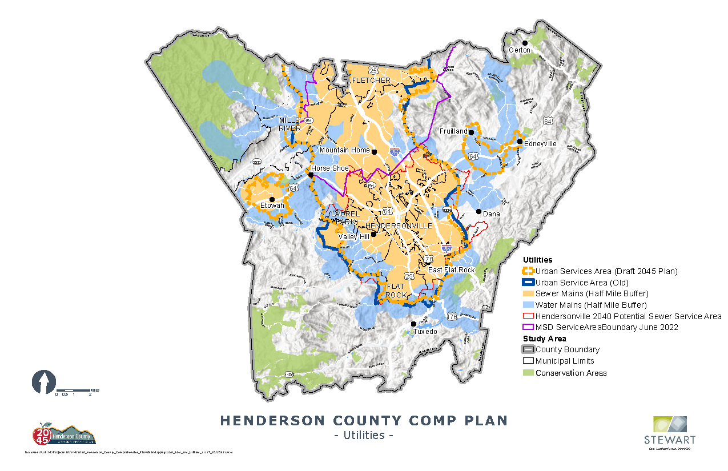
Existing Utilities Map
Utility Service Area

Slide 9
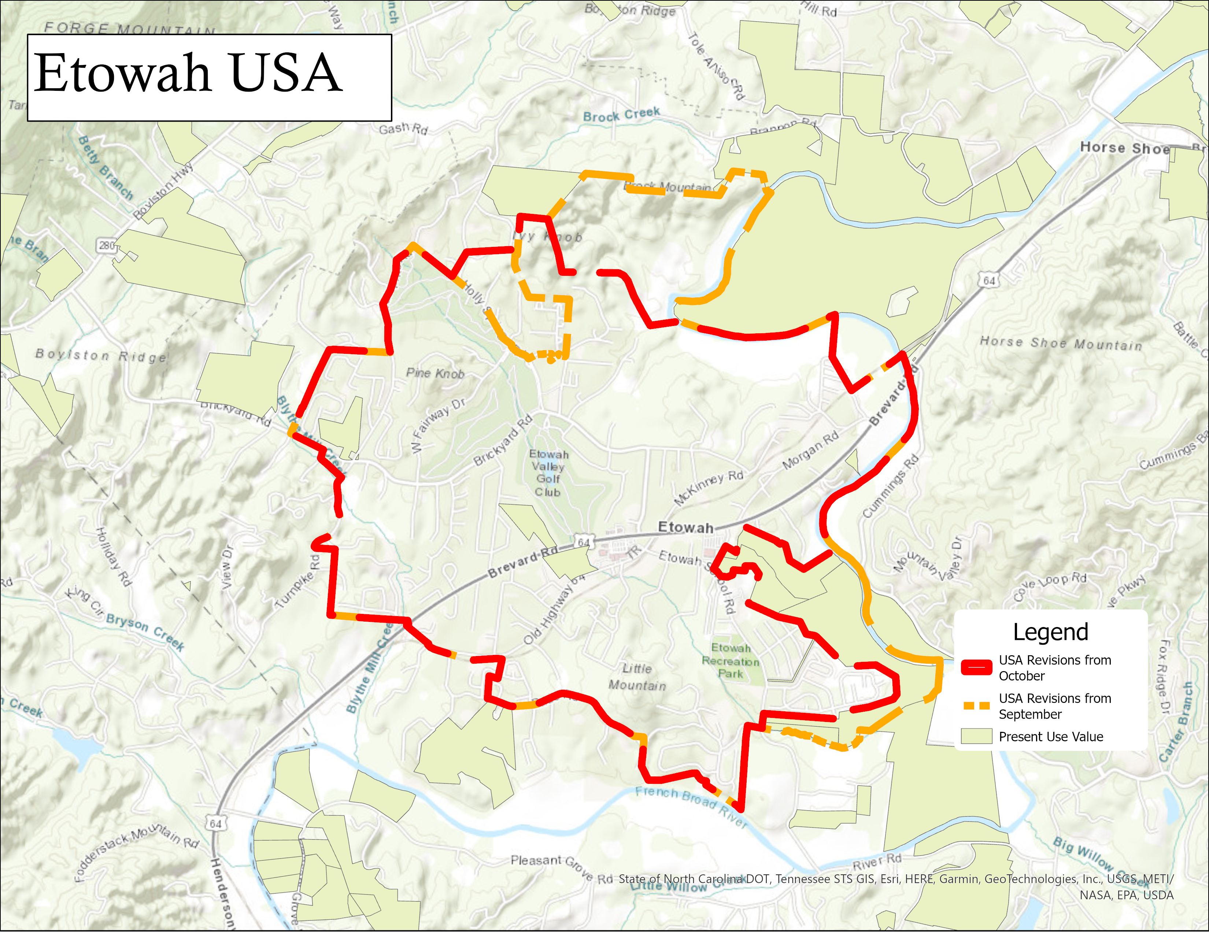

Slide 10
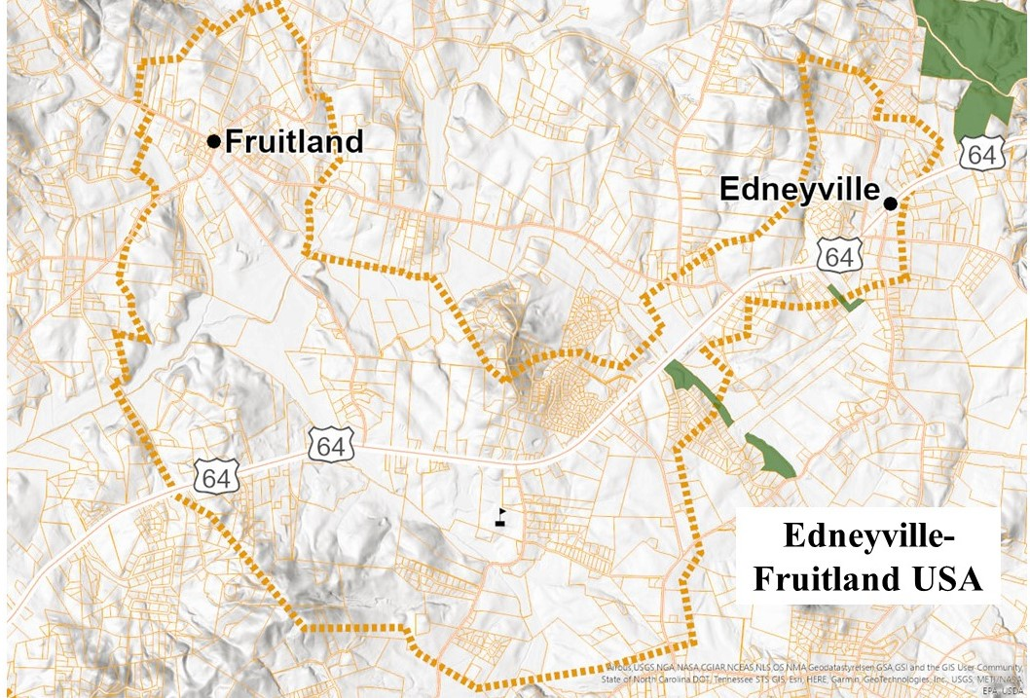
EDNEYVILLE USA

Slide 11
FUTURE LAND USE
Character Areas are NOT the same as zoning districts
One character area may represent more than one zoning district
Thorough discussion will be required when reviewing zoning and ordinance amendments to the Land Development Code
The Comprehensive Plan is a high-level document and the wording in it should be treated as such

Slide 12
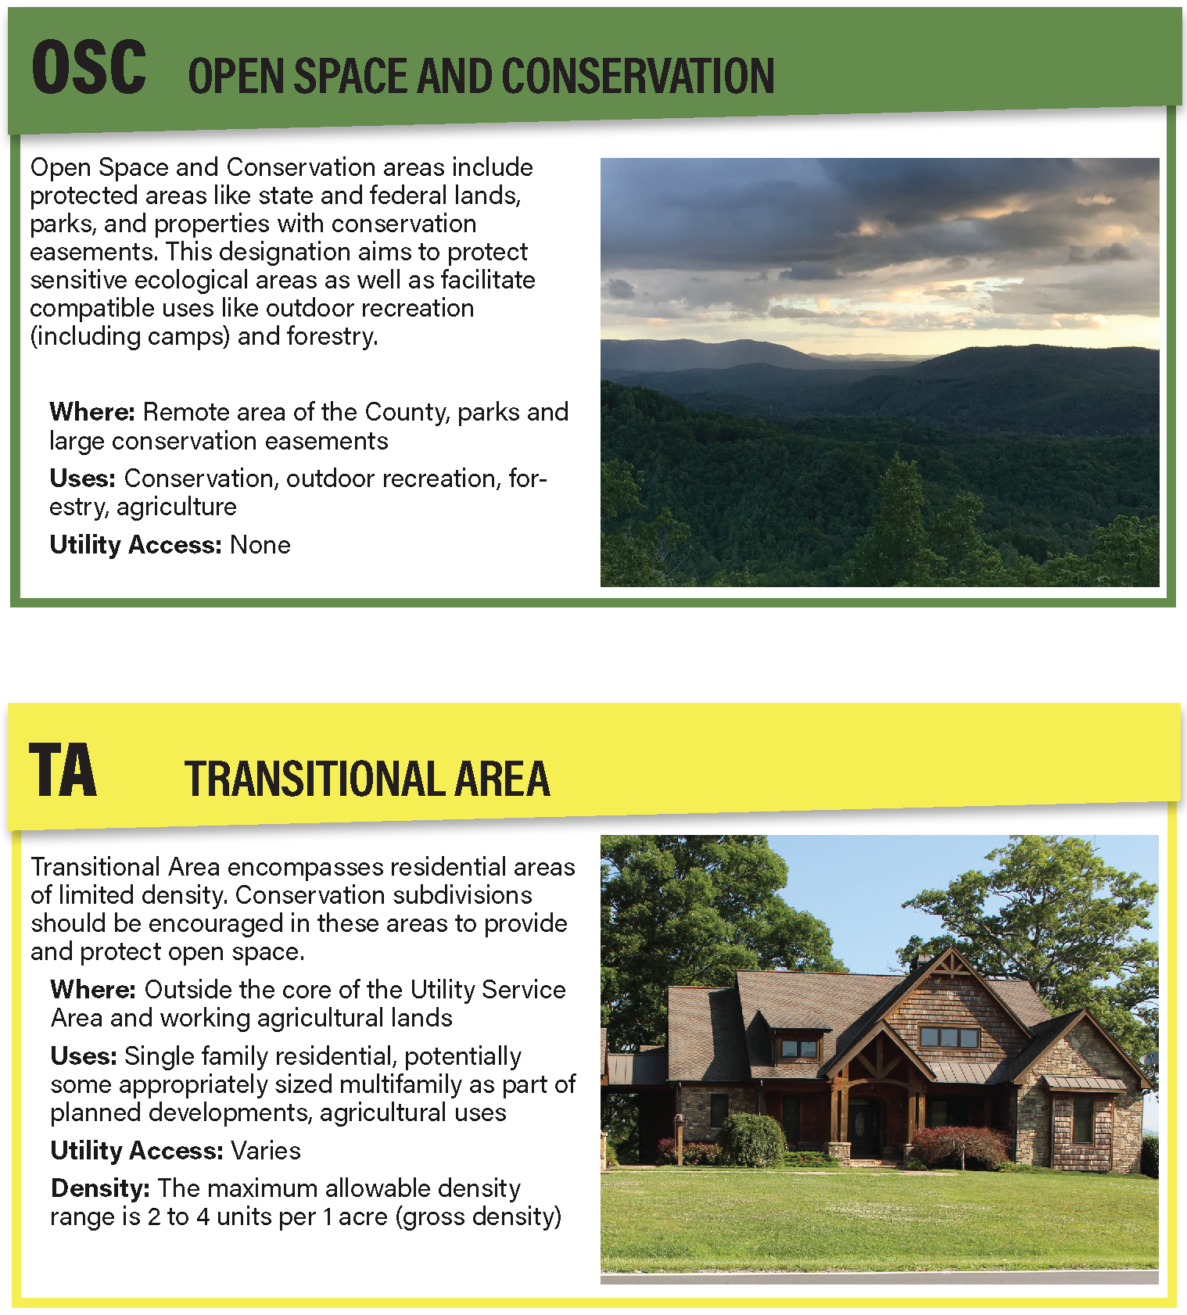
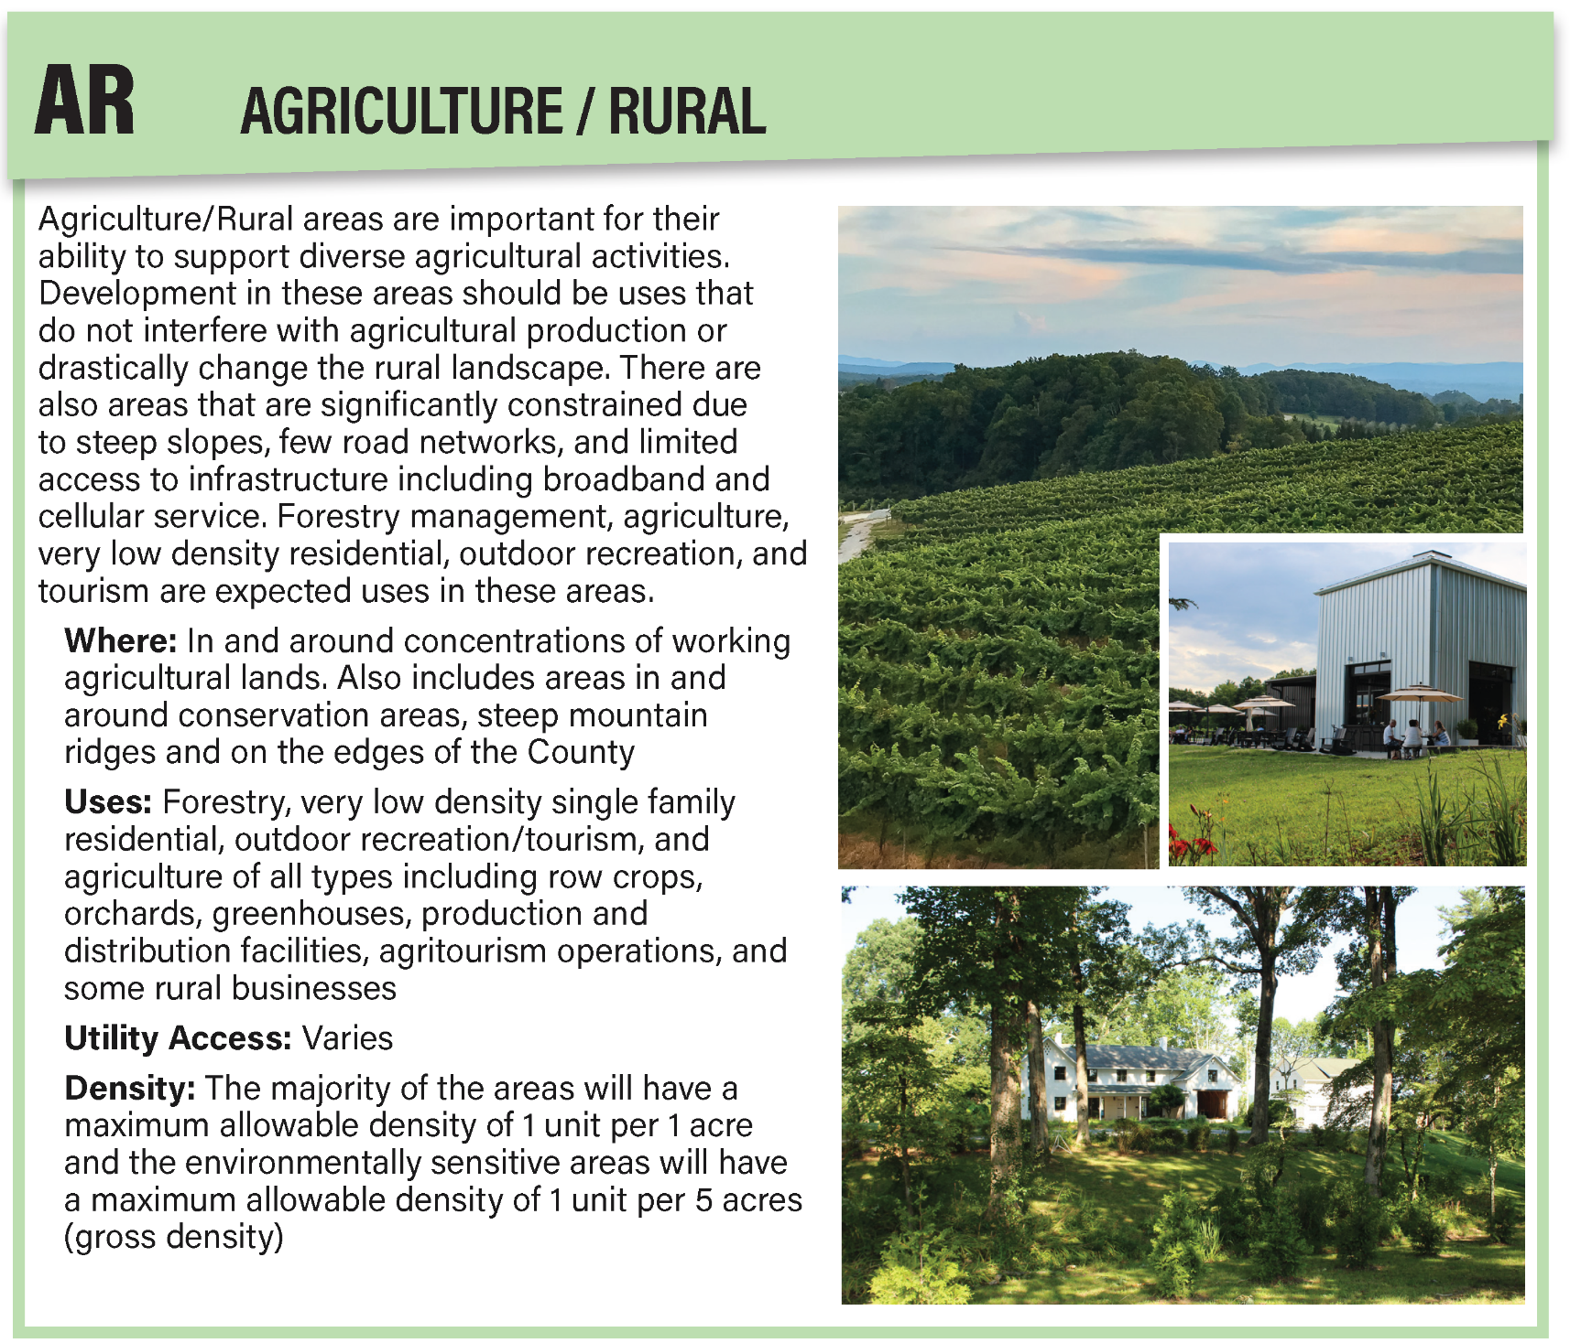
FUTURE LAND USE CHARACTER AREAS
Notes:
Went from 6 character areas to 5. Planning Board combined the Very Low Density area with the Agriculture/Rural Area

Slide 13
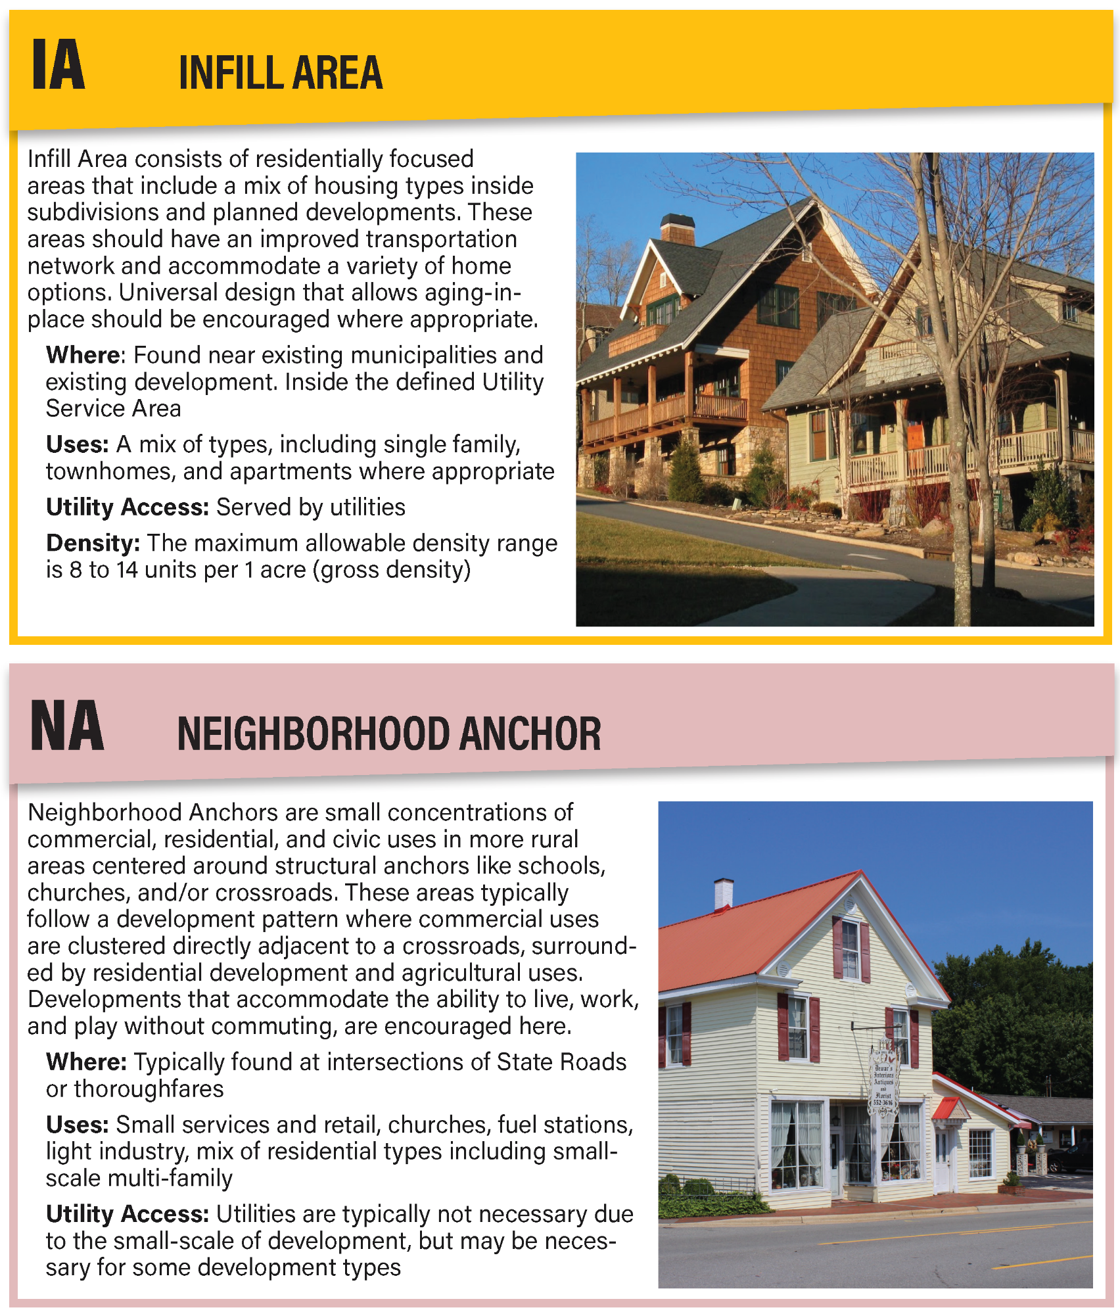
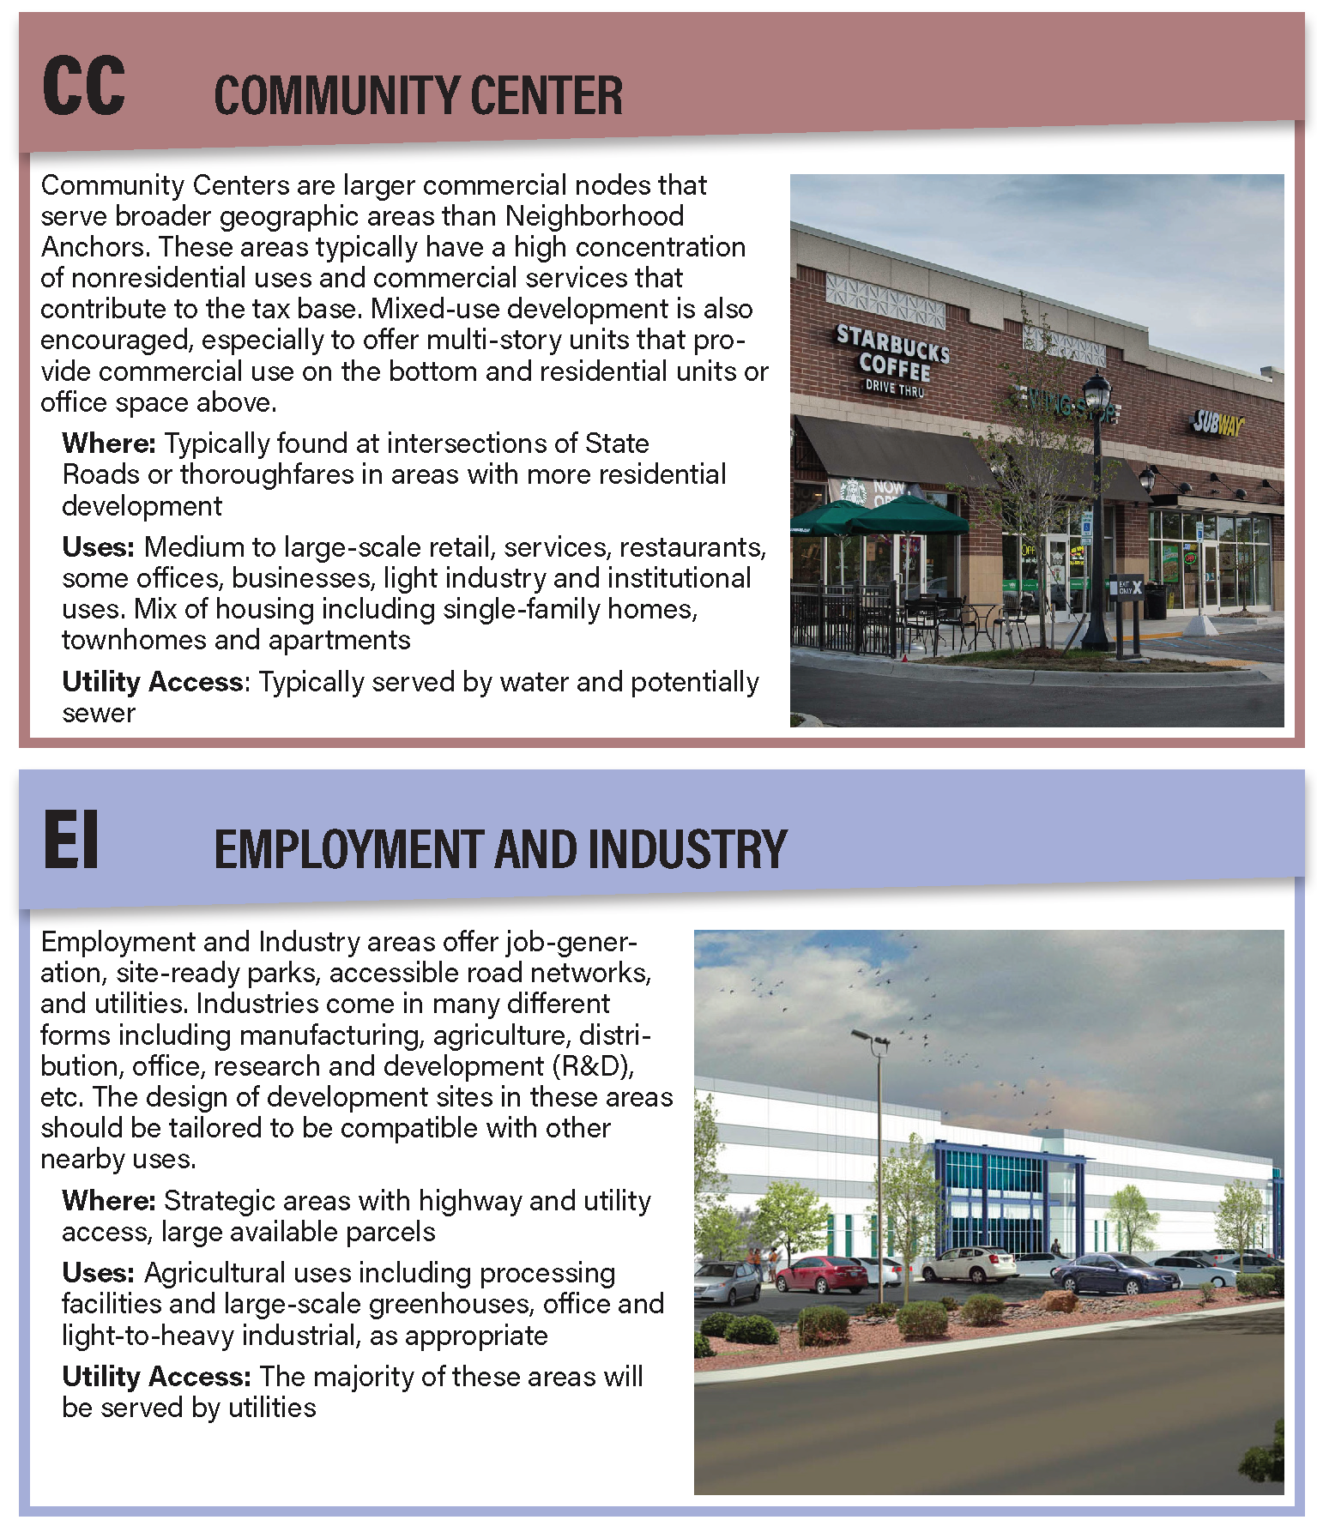
FUTURE LAND USE CHARACTER AREAS
Notes:
Add where we are now.

Slide 14
FUTURE LAND USE MAP
Highlights
Directs future residential development toward areas with infrastructure and utilities
Encourages commercial, mixed-use, and economic development in key locations and corridors
Recommends reduced density in strategic agricultural production areas
Guides development away from natural resources

Slide 15
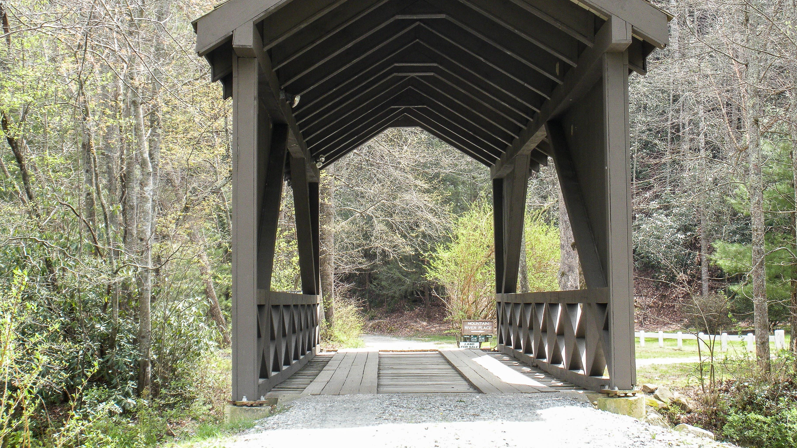
ANTICIPATED SCHEDULE

Slide 16
NEXT STEPS
November 17th: Planning Board will review revised plan and will likely recommend the plan for adoption.
December/January: New 2045 Comprehensive Plan will officially replace the existing 2020 plan.
Following Plan Adoption:
January – April: Planning Board works through the Implementation Plan.
Will provide a framework to implement recommendations and action steps
Some items are more easily implemented, some items will take several months or years to implement
Determine priority actions in the next 1-5 and 1-10 years
Implementation Plan will be a living document that is supplemental to the Adopted Plan
The Implementation Plan is intended to be consistent with the County’s 4-year budget plan
The plan should be reviewed frequently and modified as necessary
Notes:
Mention PEP Buncombe County Comp Plan beginning potentially Aug/Sep – also Hendersonville

Slide 17
QUESTIONS

